Slide 1
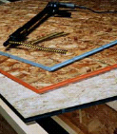
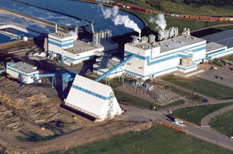




http://courses.forestry.ubc.ca/wood474
WOOD 474
Wood Properties and
Products Manufacturing
Introduction

Slide 2
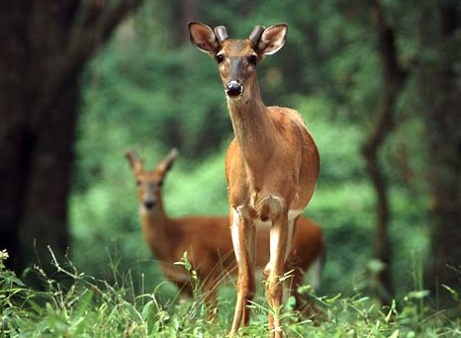
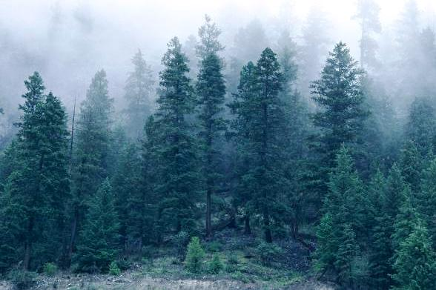
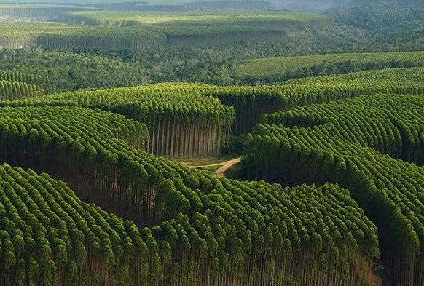


Forests satisfy multiple societal demands
Conservation
Multiple use
Production
Other
Protection

Slide 3
Global forest functions 2010
(% total area) (FAO FRA 2010)
Area = 4.03 billion ha
Notes:
FAO FRA 2010: The world's total forest area is 4.03 billion hectares.1.2 billion ha or 30% of the world’s forests are primarily used for production of wood and non-wood products. Another 24% has timber or NTFP production as on management goal. So 54% of global forest area or 2.18 billion ha of forest is used to produce forest products.

Slide 4
Global forest functions 2010
(% total area) (FAO FRA 2010)
2.18 billion ha
Notes:
FAO FRA 2010: The world's total forest area is 4.03 billion hectares.1.2 billion ha or 30% of the world’s forests are primarily used for production of wood and non-wood products. Another 24% has timber or NTFP production as on management goal. So 54% of global forest area or 2.18 billion ha of forest is used to produce forest products.

Slide 5
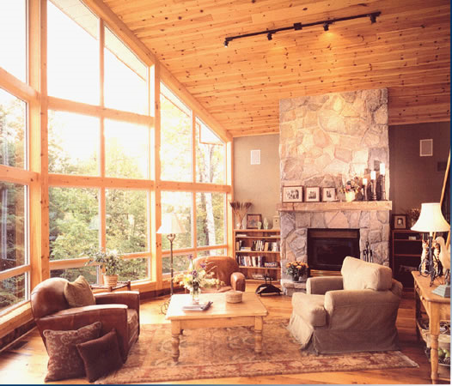
Societal use categories for forest products –global scale
Energy
Shelter
  ‘Building with wood’
  ‘Living with wood’
Communication
Packaging
Hygiene products
Other
Notes:
David Brand “ New forests 2012’ http://www.newforests.com.au/news/pdf/articles/DBrand_Investing_in_Australian_Forestry_Future.pdf
I always look at the forestry sector as serving three broad market segments—the biomass or pulp market,
which is based on the cellulosic fibre or chemical characteristics of wood; the construction market, which is
largely based on the engineering properties of wood and driven by the housing cycle; and the renovations
and furniture market based upon the grain, colour, durability, and overall appearance of timber.
The biomass-based market includes both softwood and hardwood woodchip. I usually think about softwood
pulp as being for newspapers, paper bags, and cardboard, and hardwood pulp being for printing and writing
paper, photocopy paper, and packaging. Biomass markets, however, also increasingly include energy
products, including direct combustion of wood, biochar or torrefied pellets, and liquid fuels; and platform
chemicals or biomaterials like rayon, bioplastics, and potentially new materials such as cellulose nanocrystals
that are stronger than carbon fibres or Kevlar.
The construction timber market is the central market for softwood timber as lumber or panels. There have
been efforts to displace timber with steel frame construction or plastic formwork, but so far wood has held
its own as a low embodied energy building material. The recent emergence of game changers like Cross
Laminated Timber construction with half the weight of traditional multi-story construction is a good example
of how timber can hold and even expand its market share.
The renovations and furniture market tends to be dominated by hardwoods. I always felt that the natural
timbers and stone were a key part of culture. If you go into the Rocks and see a bar with sandstone and
blackbutt flooring you know you are in Australia. You go to Canada and see granite from the Rocky
Mountains and western red cedar shakes, and you go to Sweden and see the red paned timber barns and
birch window frames. We have been losing this in Australia, but if we can successfully develop a domestic
industry around blue gum, nitens, and even spotted gum plantations we may retain this valuable market
segment and not give in to imported rubberwood flooring and Vietnamese teak furniture.
From an investment perspective, these market segments are somewhat uncorrelated and respond to
different factors in the economy. The pulp, paper, and biomass market is very technology driven, as we saw
the rise of the internet drive personal printers, but then equally the rise of the tablet start to erode
newsprint and printer paper. The issues around climate change, fossil fuels, and sustainable consumption
will drive the rise of demand for bio-energy and biomaterials into the future.
Housing and home renovations have short to medium-term linkages to the economic cycle, but also to
demographics (younger societies have more household formation, while aging societies are renovating
homes), urbanization, and the rise of the Asian middle class and disposable income.

Slide 6
Course Objectives
Course is designed to
  Provide foresters with a basic understanding of:
    wood properties and the
    manufacture of wood products
Instructors
  Course coordinator:
    Dr. Paul McFarlane
    Office – FSC 4038
    paul.mcfarlane@ubc.ca
  TA: Mr Jinguang Hu (FSC 4301)
    hujinguang113@gmail.com

Slide 7
Wood 474 – Important dates
Sept 9, 2013: first lecture
  Lectures: Monday 11 am -12.50 pm
  CAWP 2964
I will be available Wednesday 3-5pm
  but come to see me when you need to
October 21: mid term exam: 11 am
  content = up to & including 7 Oct lecture
November 18: industry visit
November 25: last class

Slide 8
Wood 474 – Course outline
Week | Date | Topic | Tutor
1 | 02-Sep | No class (Labour Day)
2 | 09-Sep | Properties of wood (wood structure) | Ellis
3 | 16-Sep | Properties of wood (mc, density, shrinkage) | Avramidis
4 | 23-Sep | Properties of wood (mechanics, strength) | Lam
5 | 30-Sep | Sawmilling and Drying | Avramidis
6 | 07-Oct | Biodeterioration and preservation | Morris/Stirling FPInnov
7 | 14-Oct | No class (Thanksgiving)
8 | 21-Oct | Midterm exam | McFarlane
9 | 28-Oct | Panels | Smith
10 | 04-Nov | Engineered wood products | McFarlane
11 | 11-Nov | No class (Remembrance Day)
12 | 18-Nov | Industry tour (sawmilling, drying, shake and shingles) | McFarlane
13 | 25-Nov | Pulp and paper/Value Chain operation | McFarlane

Slide 9
Wood 474 – Assignment of marks
Quizzes, problems & participation 10%
Report on industrial plant visit 15%
Mid-term exam 30%
Final Exam 45%

Slide 10
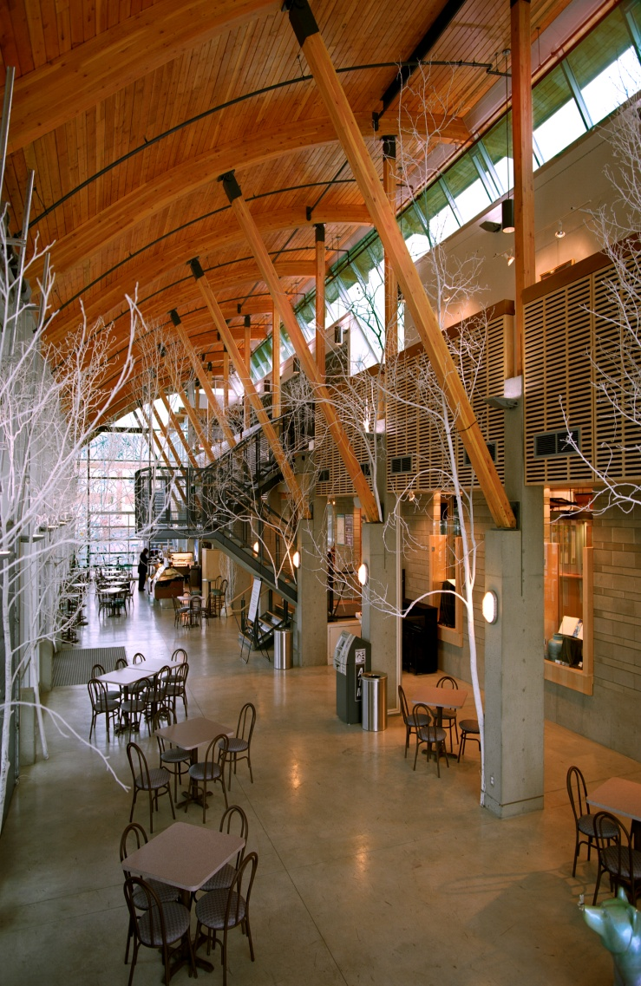
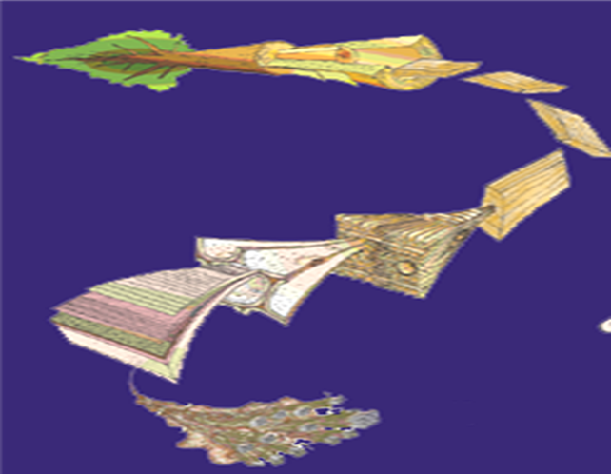
Upon completing the course
You will know about:
  Wood structure and quality
  Physical and strength properties of wood

Slide 11
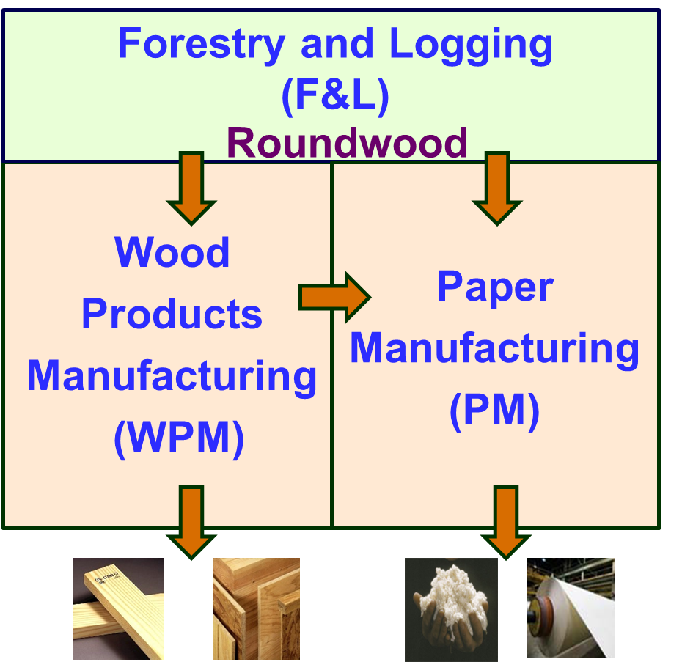
Upon completing the course
You will know about:
  Societal demand for wood products & how they are manufactured

Slide 12
